Slide 1
Are Housing Prices Affected by Natural Disasters?
Diana, Lee & Jordan

Slide 2
Methodology
Mine and Clean
Mine and clean data from FEMA and Zillow
Create Control
Create a control group by taking the population average for each month.
Merge Data
Merge the FEMA and total Zillow data sets together based on County and State.
Loop Through
Loop through the data set to find 6 months returns for each zip code affected by an event, as well as for the control group.
Conduct Test
Conduct Moods Median test to find if we were able to “prove” a positive or negative effect.

Slide 3
Data Limitations
Reliant on Zillow Data that shows only monthly data.
FEMA declaration dates could be in the middle of the month, so short term price movements may not be reflective.
Our time horizon is only 6 months, and is fairly limited in scope.
FEMA data only shows County Level information, so it was not possible to by zip code.
Zillow data only goes back to 1997, so we captured price movements during the biggest real estate bubble in modern history.
Some Zillow zip codes only contained partial data and were excluded from the analysis.

Slide 4
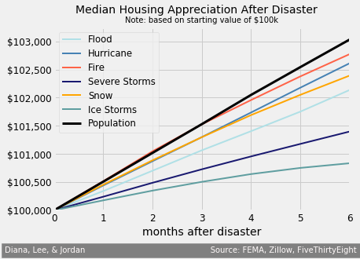
Do Natural Disasters Affect Real-Estate Prices?
Every single FEMA classified event appears to have an effect on Real-Estate prices.
Some appear to have a greater affect than others.
The frequency of these events could have an impact on prices, as well as the location these event occur.

Slide 5
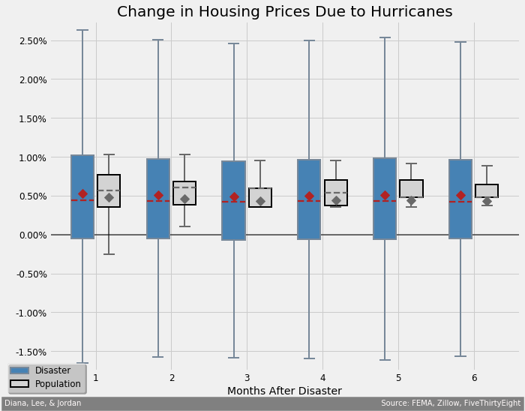
Hurricane Output
Null Hypothesis of no affect on real-estate prices was rejected for all 6 months in this data set.
Zip codes affected clearly showed significant volatility.
Median home price growth was significantly lower.
Research into what drives the skewness of this distribution as it is not normally distributed.

Slide 6
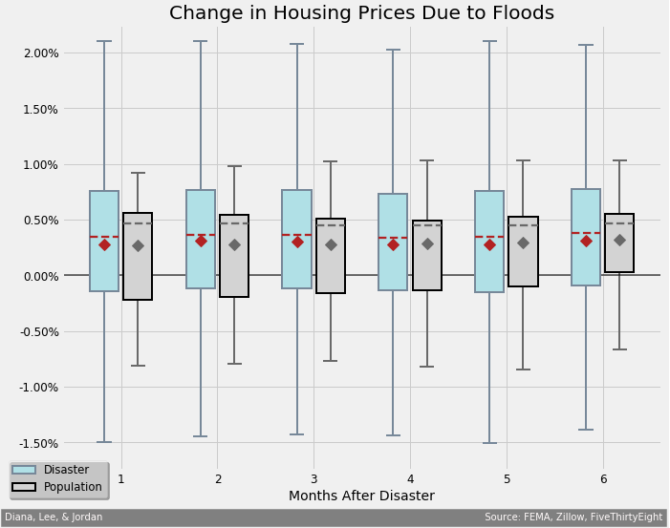
Flood Output
Null Hypothesis of no affect on real-estate prices was rejected for all 6 months in this data set.
Zip codes affected clearly showed significant volatility.
Like with hurricanes there was a negative impact on median home prices.

Slide 7
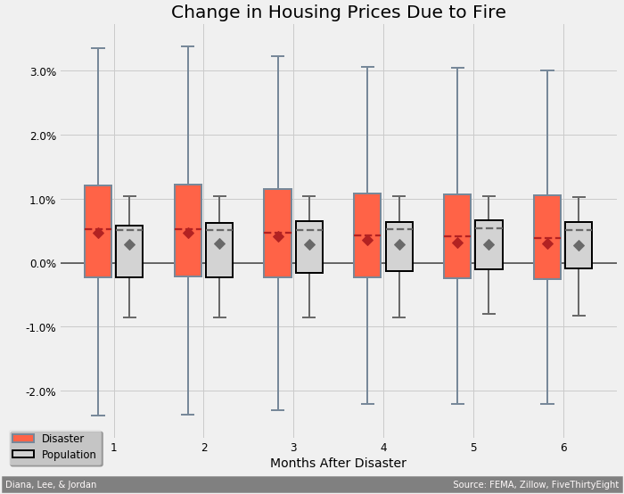
Fire Output
This was our most volatile dataset of all observations.
Null Hypothesis was rejected for every month.
One possibility for the higher home price growth in this data set could be due to a lower supply of homes, with little to no change in demand. Further research is required.

Slide 8
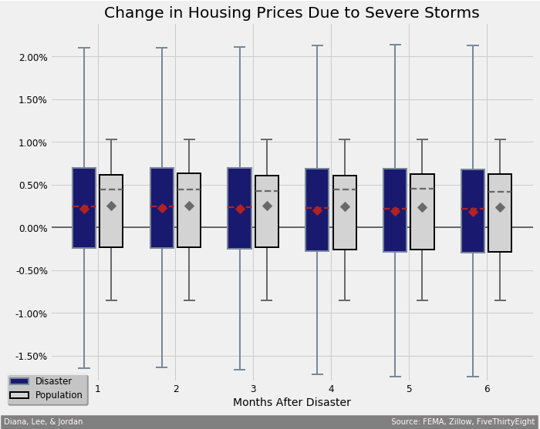
Severe Storms Output
Null Hypothesis of no affect on real-estate prices was rejected for all 6 months in this data set.
The effect on home prices appears to be normally distributed.

Slide 9
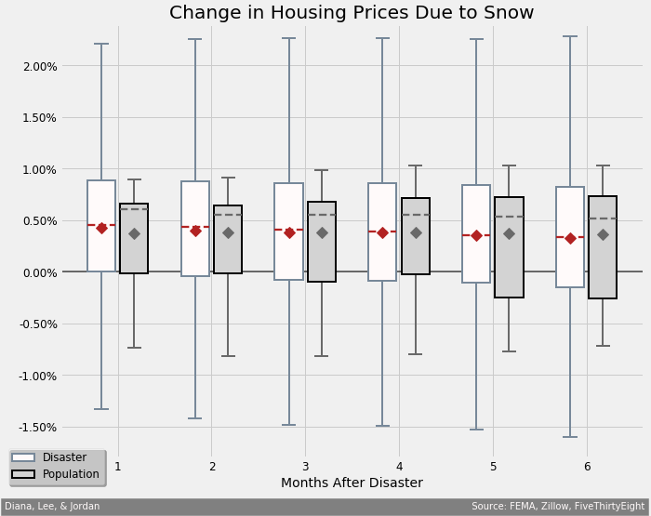
Snow Storm Output
Like with severe storms, the null hypothesis was rejected for all six months.
Like with severe storms, the results appear to be normally distributed.
The later months appear to start to show a slightly increasing negative impact.

Slide 10
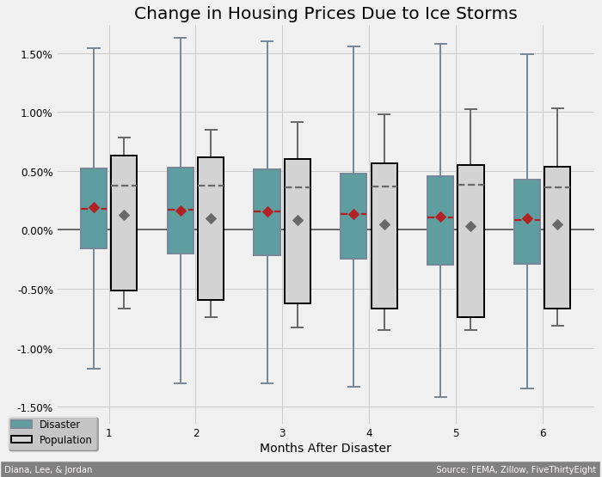
Ice Storm Output
Like with snow storms, the null hypothesis was rejected for all six months.
This data sets was the smallest observation set with 4,950 zip codes involved in a natural disaster.
Since the small data set this could suffer from multicollinearity with broader economic forces.

